Slide 1
hour 9
World Building:
The Anatomy of a Level

Slide 2
Introduction
When you first create a new project, the Editor creates a default Level for you to work with. The default Level has a few already-placed Actors that are needed. This lecture will cover what goes into setting up a Level and what each of these Actors, as well as a few other beneficial Actors, are used for.
While relying on the default Level can speed things up when starting a new Level, it is important to understand what goes into setting up a Level from scratch. Even with a default Level, you will eventually have to modify or make changes to the already-placed assets based on your project’s needs.

Slide 3
Lecture Goals and Outcomes
The goals of this lecture are to
Learn to create a new Level
Learn about all the Actors that are needed for a typical Level setup
Become familiar with Fog Actors
Learn about Reflection Capture Actors
Learn about Lightmass Importance Volumes
Become familiar with Post Process Volumes
By the end of this lecture you will be able to
Create a default Level
Create a blank Level
Manually add the necessary Actors to a blank Level

Slide 4
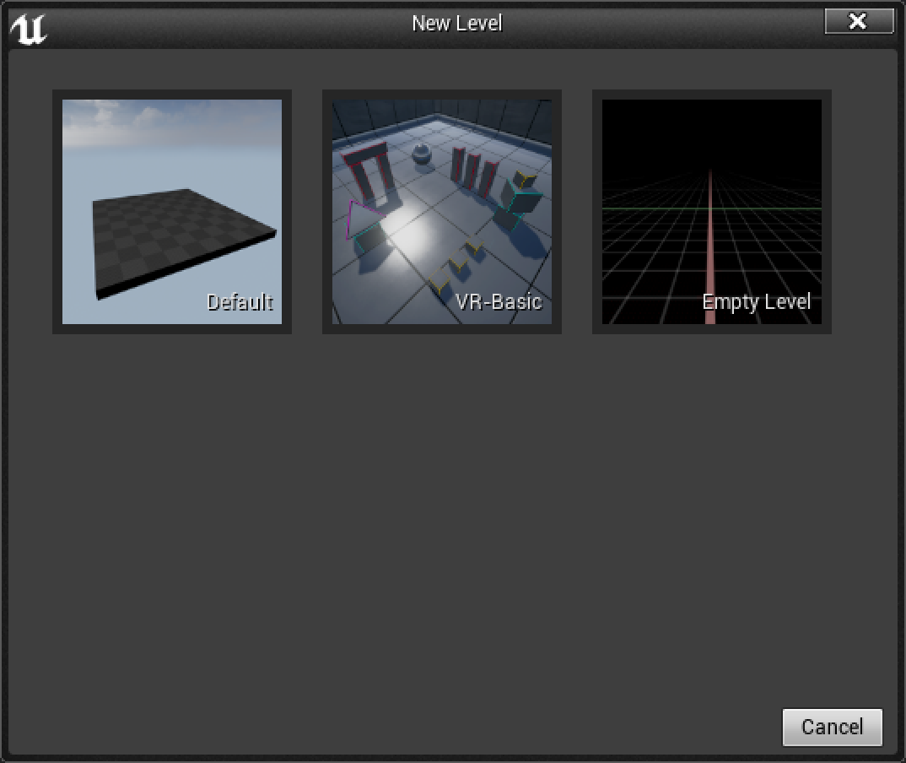
Creating a new Level
To create a new Level, go to the File menu on the main Editor interface and choose New Level.
Here you are presented with three options:
Default: This Level contains a small collection of Actors that are commonly needed in a Level.
VR-Basic: This Level is already set up for testing out VR rigs.
Empty Level: This is a Level with nothing in it, ready to be used for whatever your project needs.

Slide 5
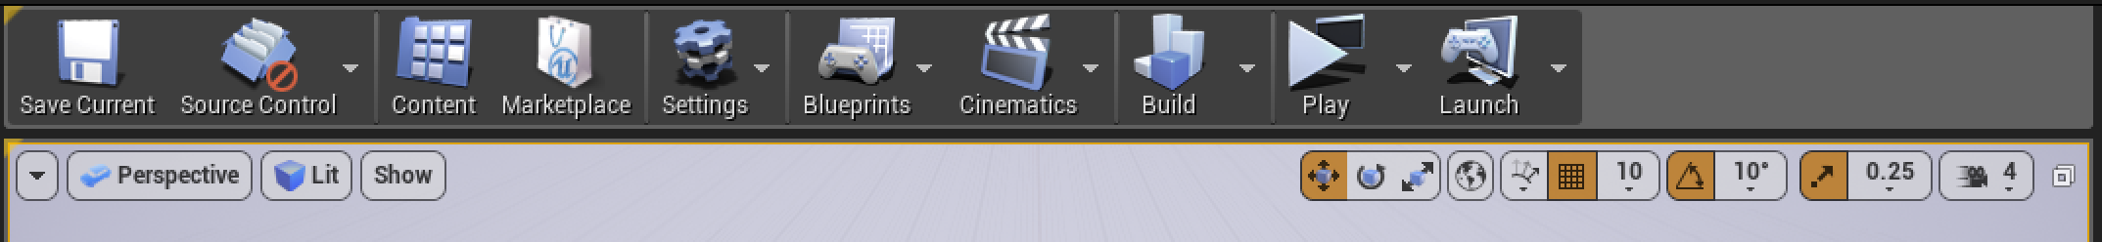
Creating a new Level
Once you make a new Level, it is opened automatically in the Level Viewport, but it won’t have a name or a location in the Content Browser until you save it.
To save the new Level:
Select Save Current on the Level Editor toolbar.
In the Save Level As dialog, choose a location in your project’s Content folder.
Saving a Level creates a .umap file in the Content folder.

Slide 6
World Building
Good organization goes a long way. Create a folder in the Content Browser and call it Maps. Save any Levels in your project to this folder.
When creating a new Level, never put spaces in its name. For example, “My Default Level” should be MyDefaultLevel or My_Default_Level.

Slide 7
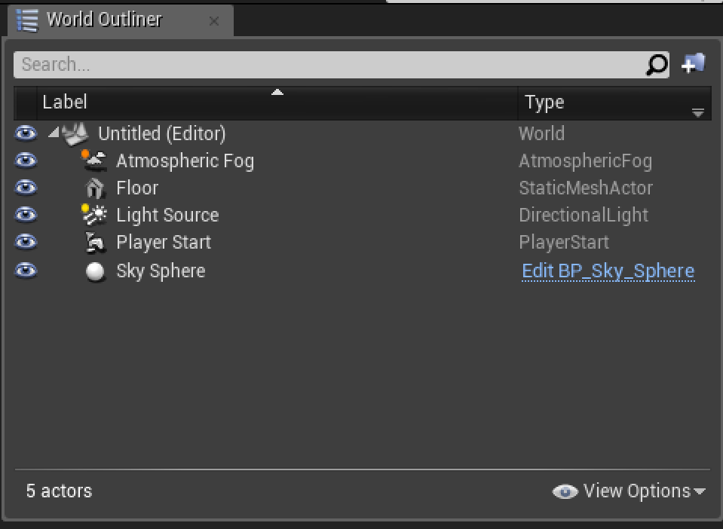
world outliner
In the World Outliner for the default Level, you will see that the Level is already populated with some Actors:
Atmospheric Fog Actor
Floor (Static Mesh Actor)
Light Source (Directional Light Actor)
Player Start Actor
Sky Sphere (Blueprint Actor)

Slide 8
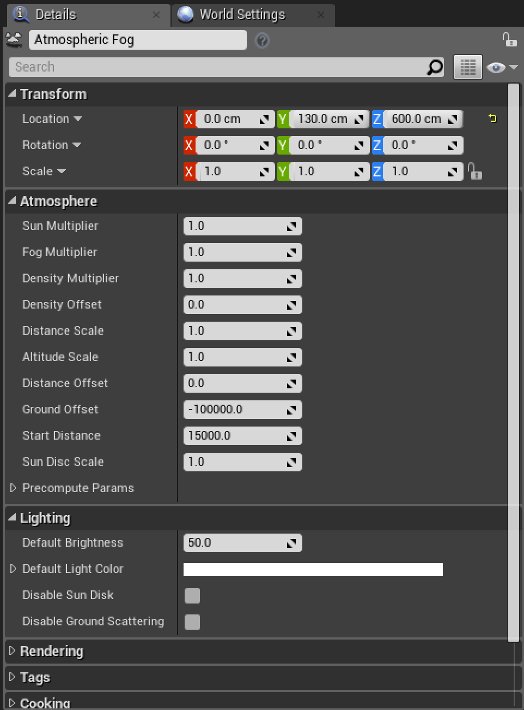
Atmospheric fog Actor
The Atmospheric Fog Actor is typically used with exterior Levels and approximates atmospheric light scattering. It works directly with a Directional Light Actor placed in the Level.
The Atmospheric Fog Actor is located in the Modes panel under Visual Effects.

Slide 9
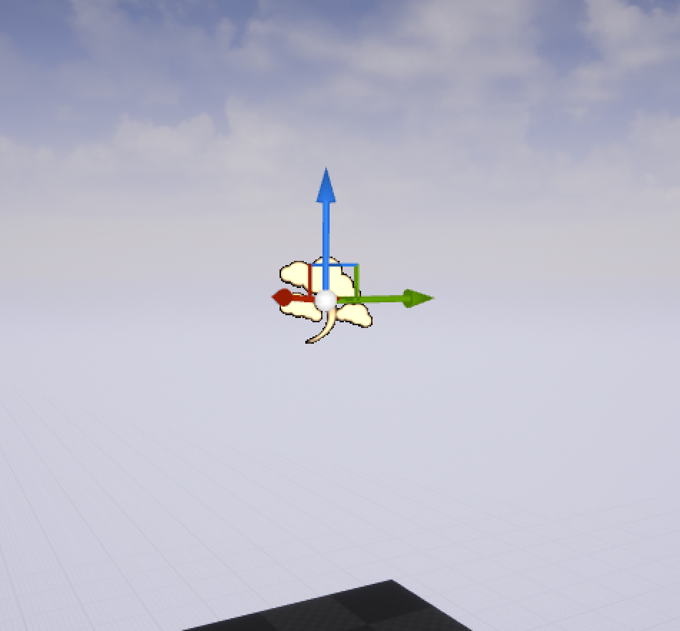
Atmospheric fog Actor
Fog was once typically used to hide the fact that a Level was small with few assets or to occlude far-off assets to improve rendering efficiency. Now fog is more of an aesthetic choice.

Slide 10
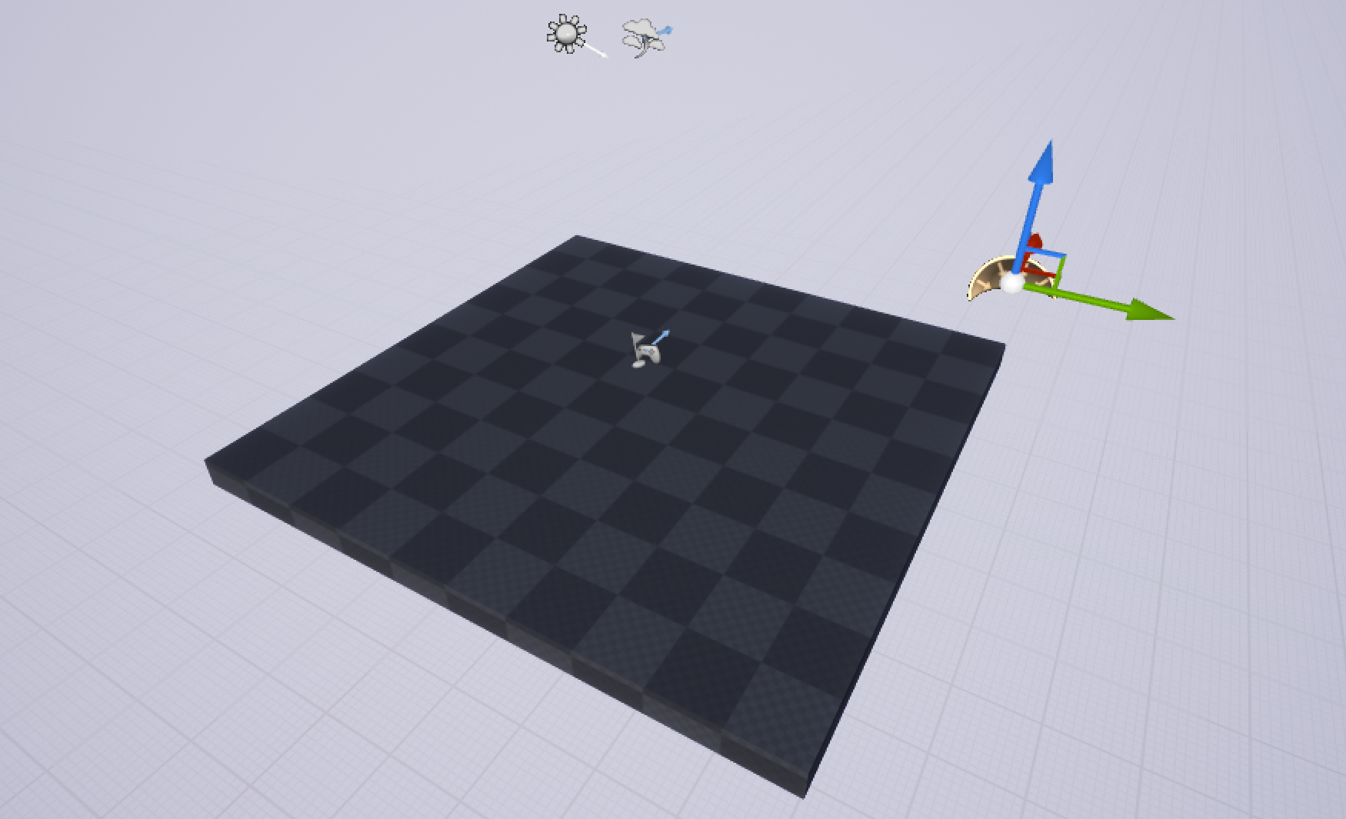
Floor ACTOR
In the default Level, there is a Static Mesh Actor called Floor.
If a player’s Pawn Actor spawns into a Level and there is no floor, the Pawn will fall indefinitely.
Ground planes can be any of the following:
Static Mesh Actors
Terrain Actors
Additive BSP Brush Actors

Slide 11
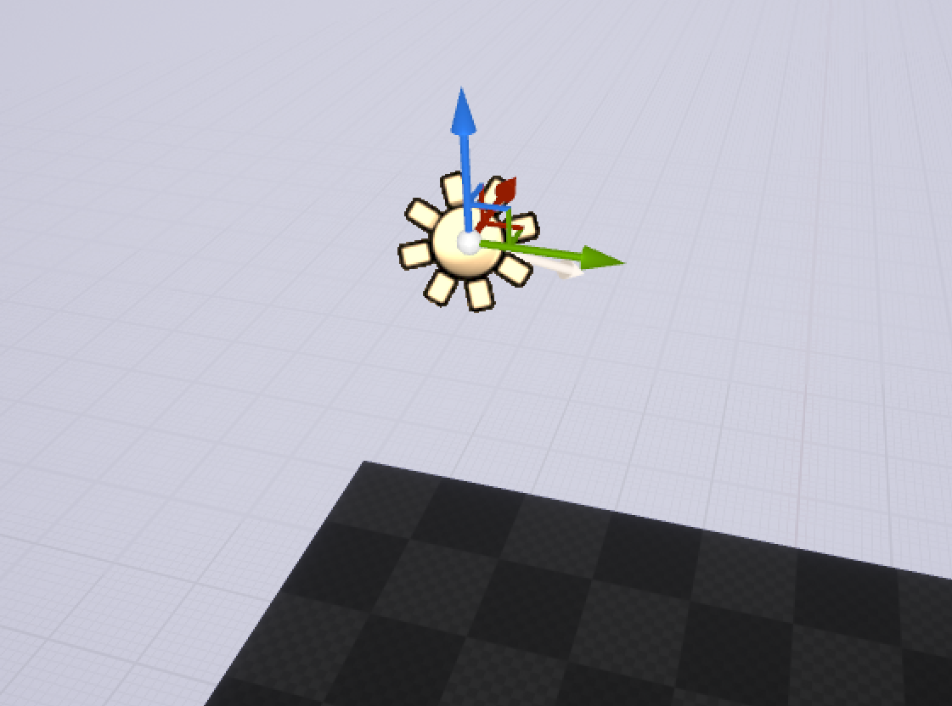
Directional Light Actor
The location of the Directional Light Actor does not matter, just its orientation/rotation.
The Directional Light Actor is located in the Modes panel under the Lights category.
Even when working with an interior scene, it is a good idea to have a Directional Light Actor in your Level to simulate sunlight.

Slide 12
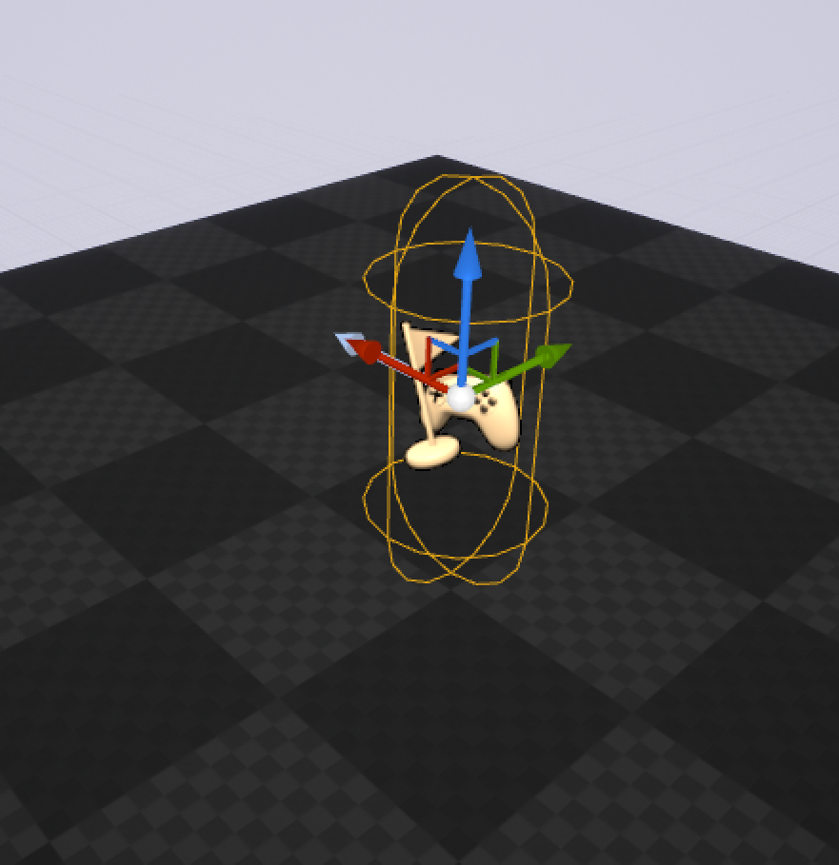
Player Start Actor
The Player Start Actor is used to define where the player’s Pawn will spawn into the world.
If a Level does not have a Player Start, the player’s Pawn will attempt to spawn in at the 0,0,0 coordinates.
The Player Start Actor is located in the Modes panel under the Basic category.

Slide 13
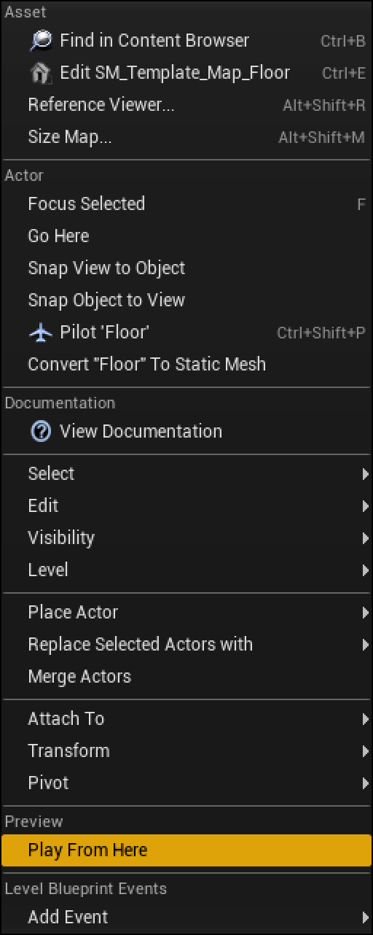
Player Start actor
When working with and playtesting your Level, you may not want to start at the Player Start location.
You can choose a different location by right-clicking in the Editor Viewport and using the Play From Here option.

Slide 14
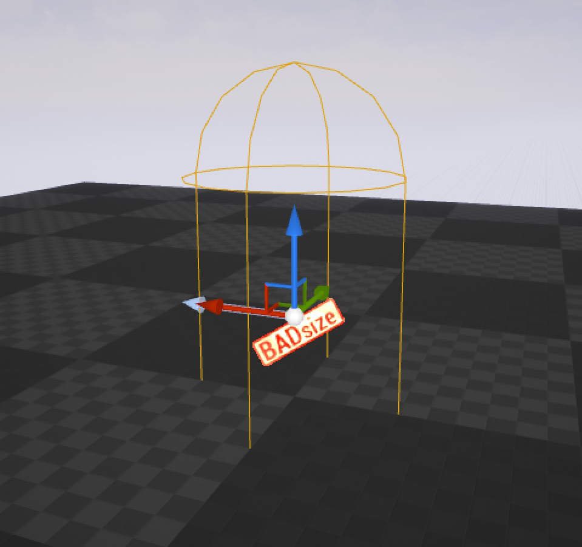
Player Start ACTOR
Sometimes your Player Start icon might change from an icon of a controller to an icon that says “BADsize”.
This happens because the Player Start Actor’s collision hull is intersecting with another Actor’s collision hull.
All you need to do is move your Player Start around in the world until it is not intersecting anything in the scene.

Slide 15
Can you Have multiple Player Start Actors?
Yes!
For example, if you are working on a multiplayer deathmatch Level, you will need multiple Player Start Actors, or if you are creating a respawn system for a single-player Level, you might use multiple Player Start Actors.
Note: Both of these examples will require a little bit of Blueprint scripting to function.

Slide 16
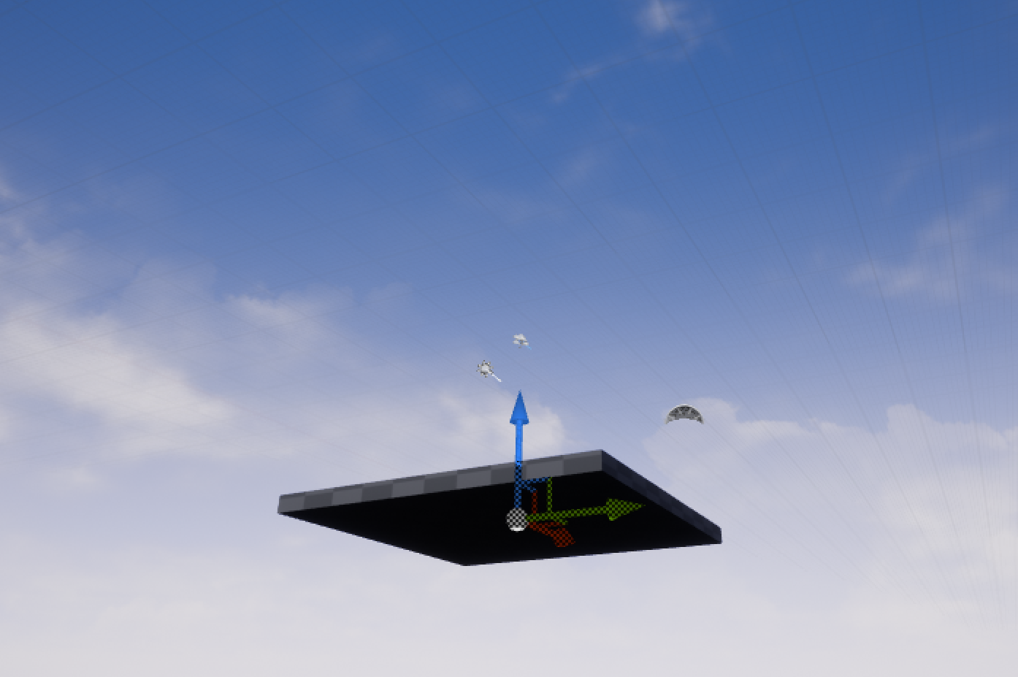
Sky Sphere Blueprint Actor
The final Actor listed in the World Outliner of a default Level is the Sky Sphere Blueprint Actor. It is a Blueprint Actor with a Static Mesh component that references a sphere whose vertex normals are flipped and facing inward.

Slide 17
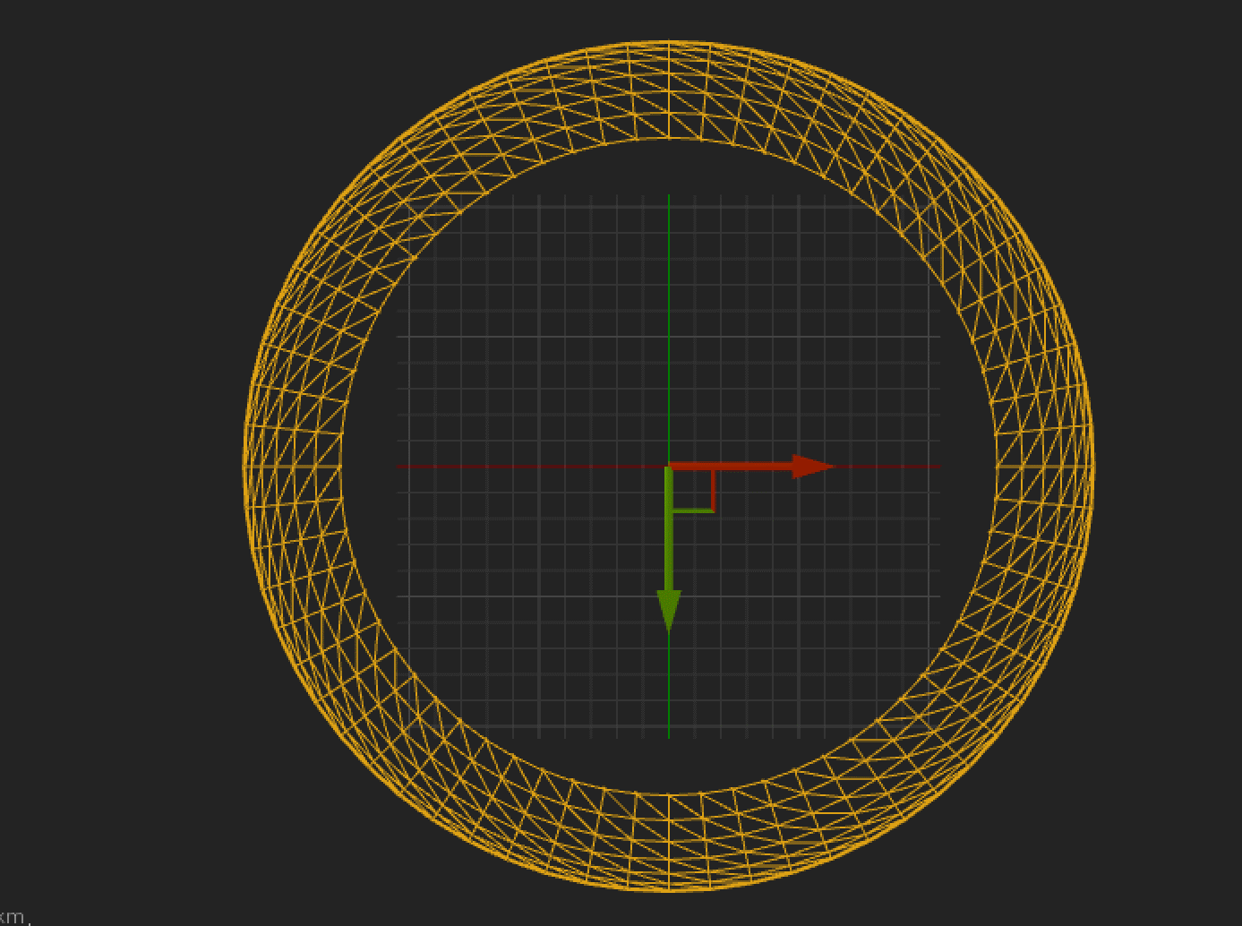
Sky Sphere Blueprint Actor
The Sky Sphere Blueprint Actor works with a Material asset called M_Sky_Panning_Clouds2 and the Directional Light Actor in the Level to create a sky with clouds and a sun disk.
The Static Mesh component is scaled larger than the Level bounds.

Slide 18
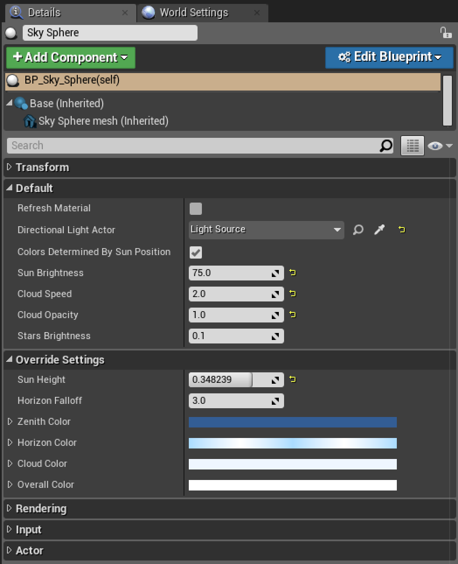
Sky Sphere Blueprint Actor
In order to determine where the sun should be located in the sky, the Sky Sphere is linked to the Directional Light’s rotation.
To link a Directional Light to the Sky Sphere Actor:
Select the Sky Sphere and go to the Details panel.
Click on the eye dropper icon.
Click on the Directional Light in the Level Viewport.

Slide 19
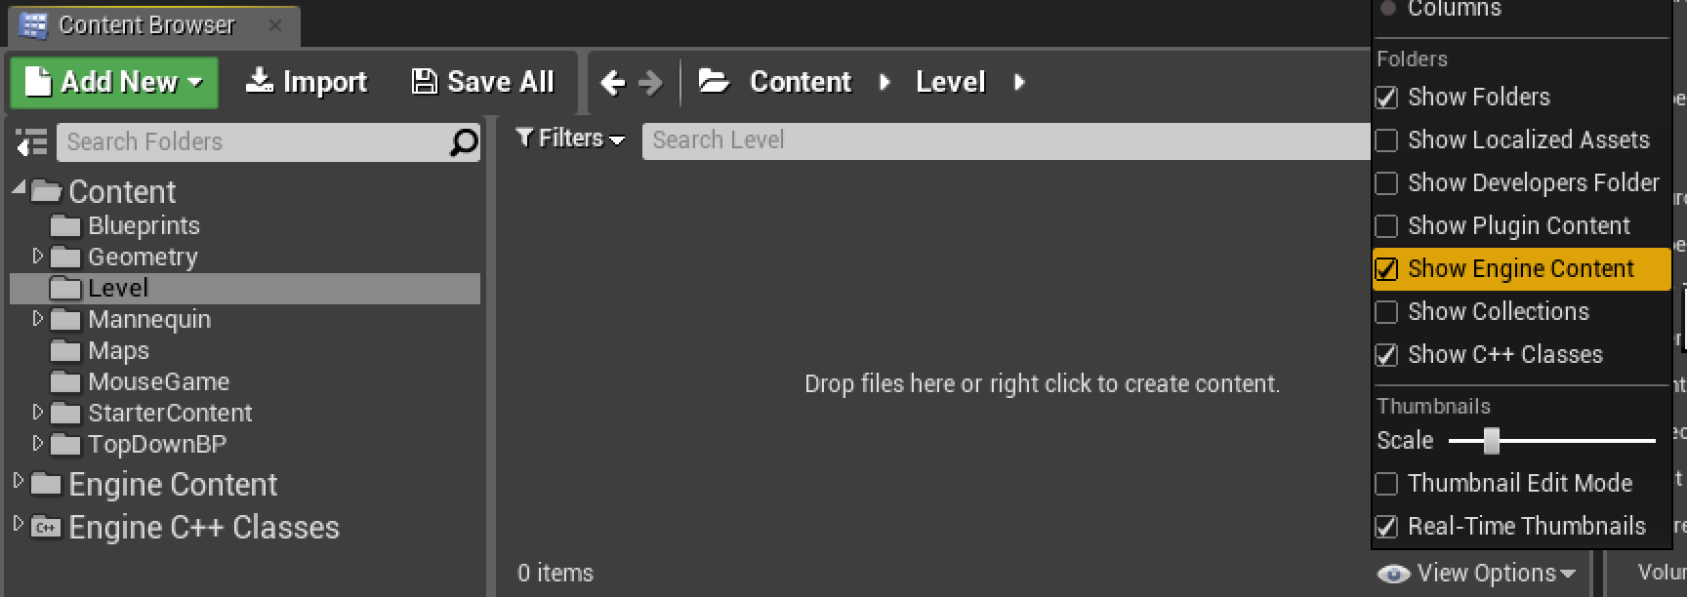
Content Browser View Options
The Sky Sphere Blueprint Actor is located in the Engine’s Content folder in the Content Browser.
Located in the lower-right corner of the Content Browser are view options that allow you to change the viewing preference of the Content Browser.
You must enable Show Engine Content to display the assets included with the engine.
Note: You should never modify any of the assets in the Engine’s Content folder. If you need to, copy that asset into your own project directory and modify it there.

Slide 20
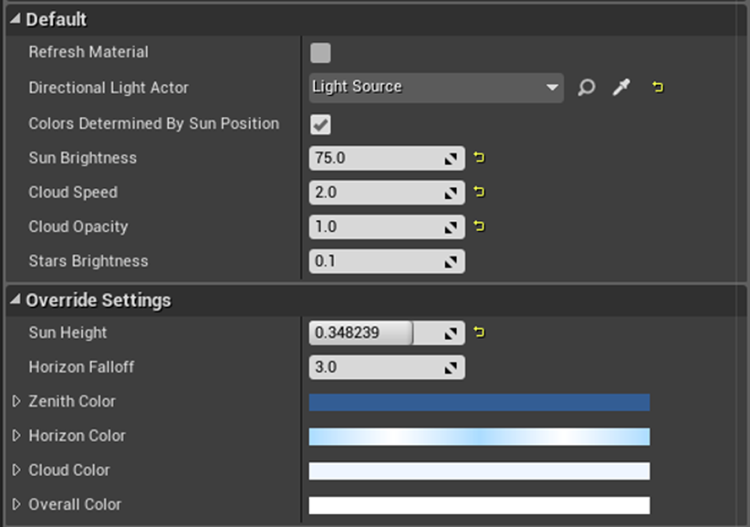
How do you make it Nighttime?
Rotating the Directional Light so light comes from underneath the ground will make it nighttime. You can then use the Stars Brightness property to control the light’s intensity.

Slide 21

Sky sphere colors
It is also possible to manually control the Sky Sphere colors.
Select the Sky Sphere Actor and go to the Details panel.
Turn off Colors Determined By Sun Position.
Use the override settings.

Slide 22
Other Actors to Consider
While the default Level has a collection of already-placed Actors needed for setting up a Level, there are at least five other Actors that a Level will benefit from.
Sky Light Actor
Exponential Height Fog Actor
Lightmass Importance Volume
Reflection Capture Actors
Post Process Volume

Slide 23
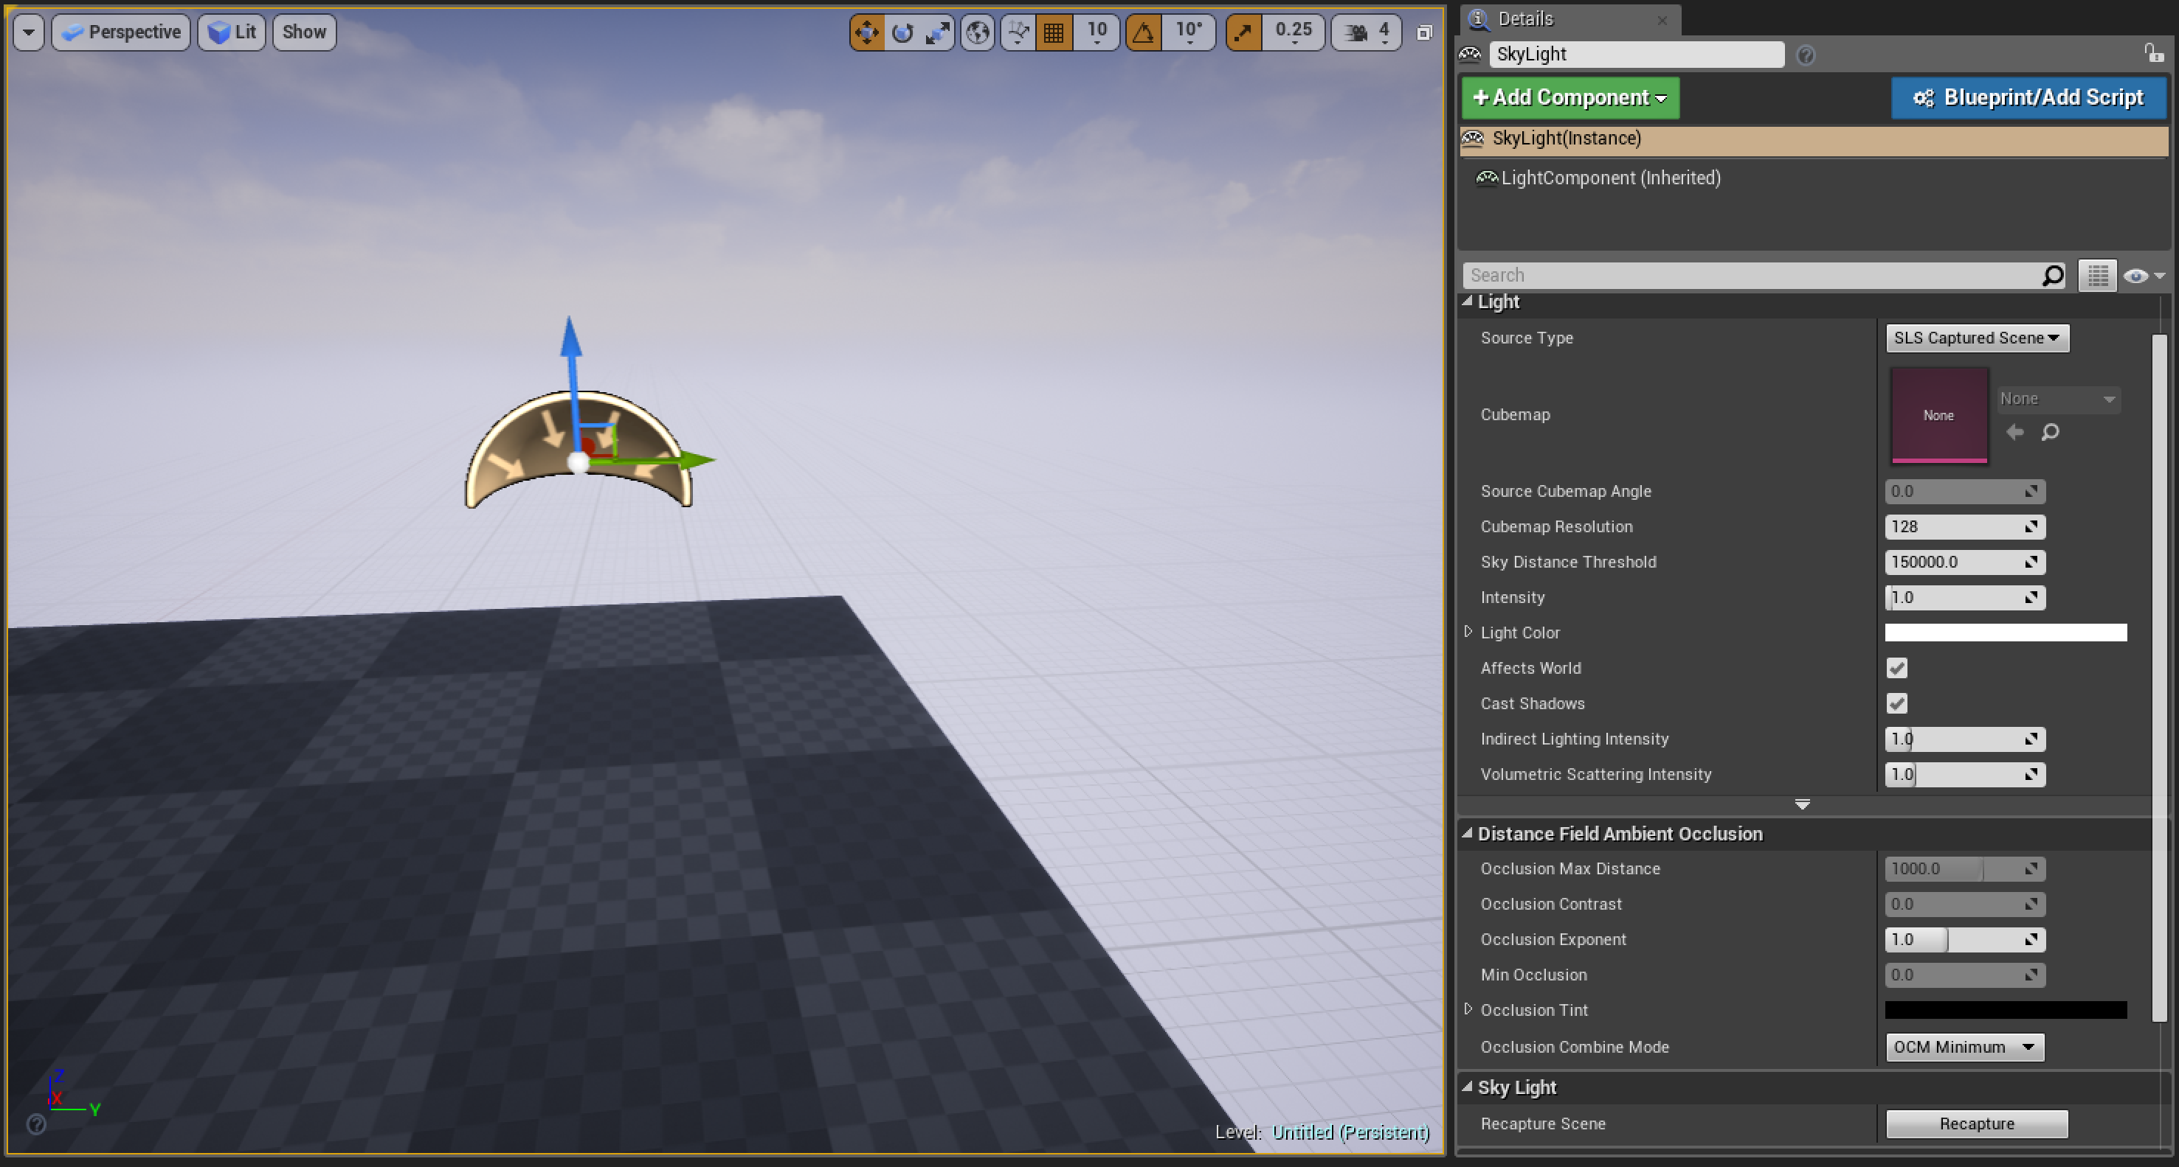
Sky Light Actor
Although a Sky Light Actor is not included in the default Level, it is a good idea to add one.
A Sky Light Actor creates an ambient light form in all directions.
Since a Sky Light Actor does not cast dynamic shadows but can add uniform lighting, it can be used to brighten up dark areas in your Level and to provide color tinting to shadows.
The Sky Light Actor is located in the Modes panel under the Lights category.

Slide 24
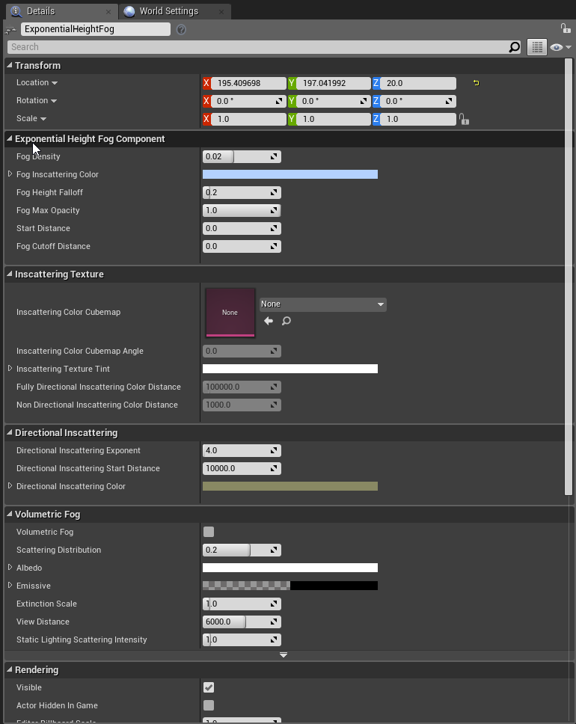
Exponential Height fog Actor
The Exponential Height Fog Actor controls fog density in the Level based on height. Lower areas in a Level have higher density than higher areas.
The Exponential Height Fog Actor is located in the Modes panel under Visual Effects.
Note: While the default Level only has an Atmospheric Fog Actor, it is acceptable to use both an Exponential Height Fog Actor and an Atmospheric Fog Actor in a Level. Fog Actors affect the entire Level, so you only need one of each in a Level.

Slide 25
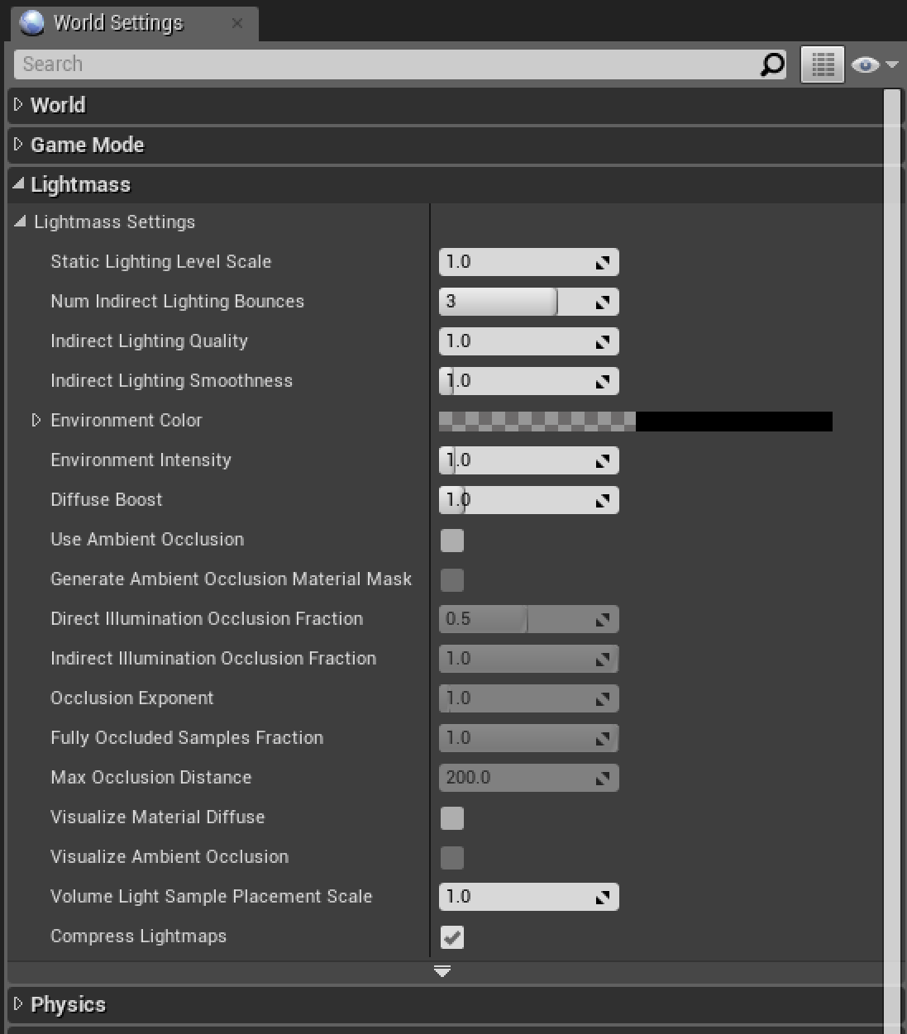
Lightmass Importance Volume
When you build lighting, the engine calculates the number of times light bounces around the Level (three bounces by default).
You can adjust this number by using the Lightmass properties in the World Settings panel. The more bounces, the longer it takes to build lighting for Actors with a mobility setting of Static.
If light hits a surface and bounces off and continues to travel without ever hitting another surface, the engine will continue to process the light until it leaves the Level. This processing will also increase the amount of time it takes to build lighting.

Slide 26
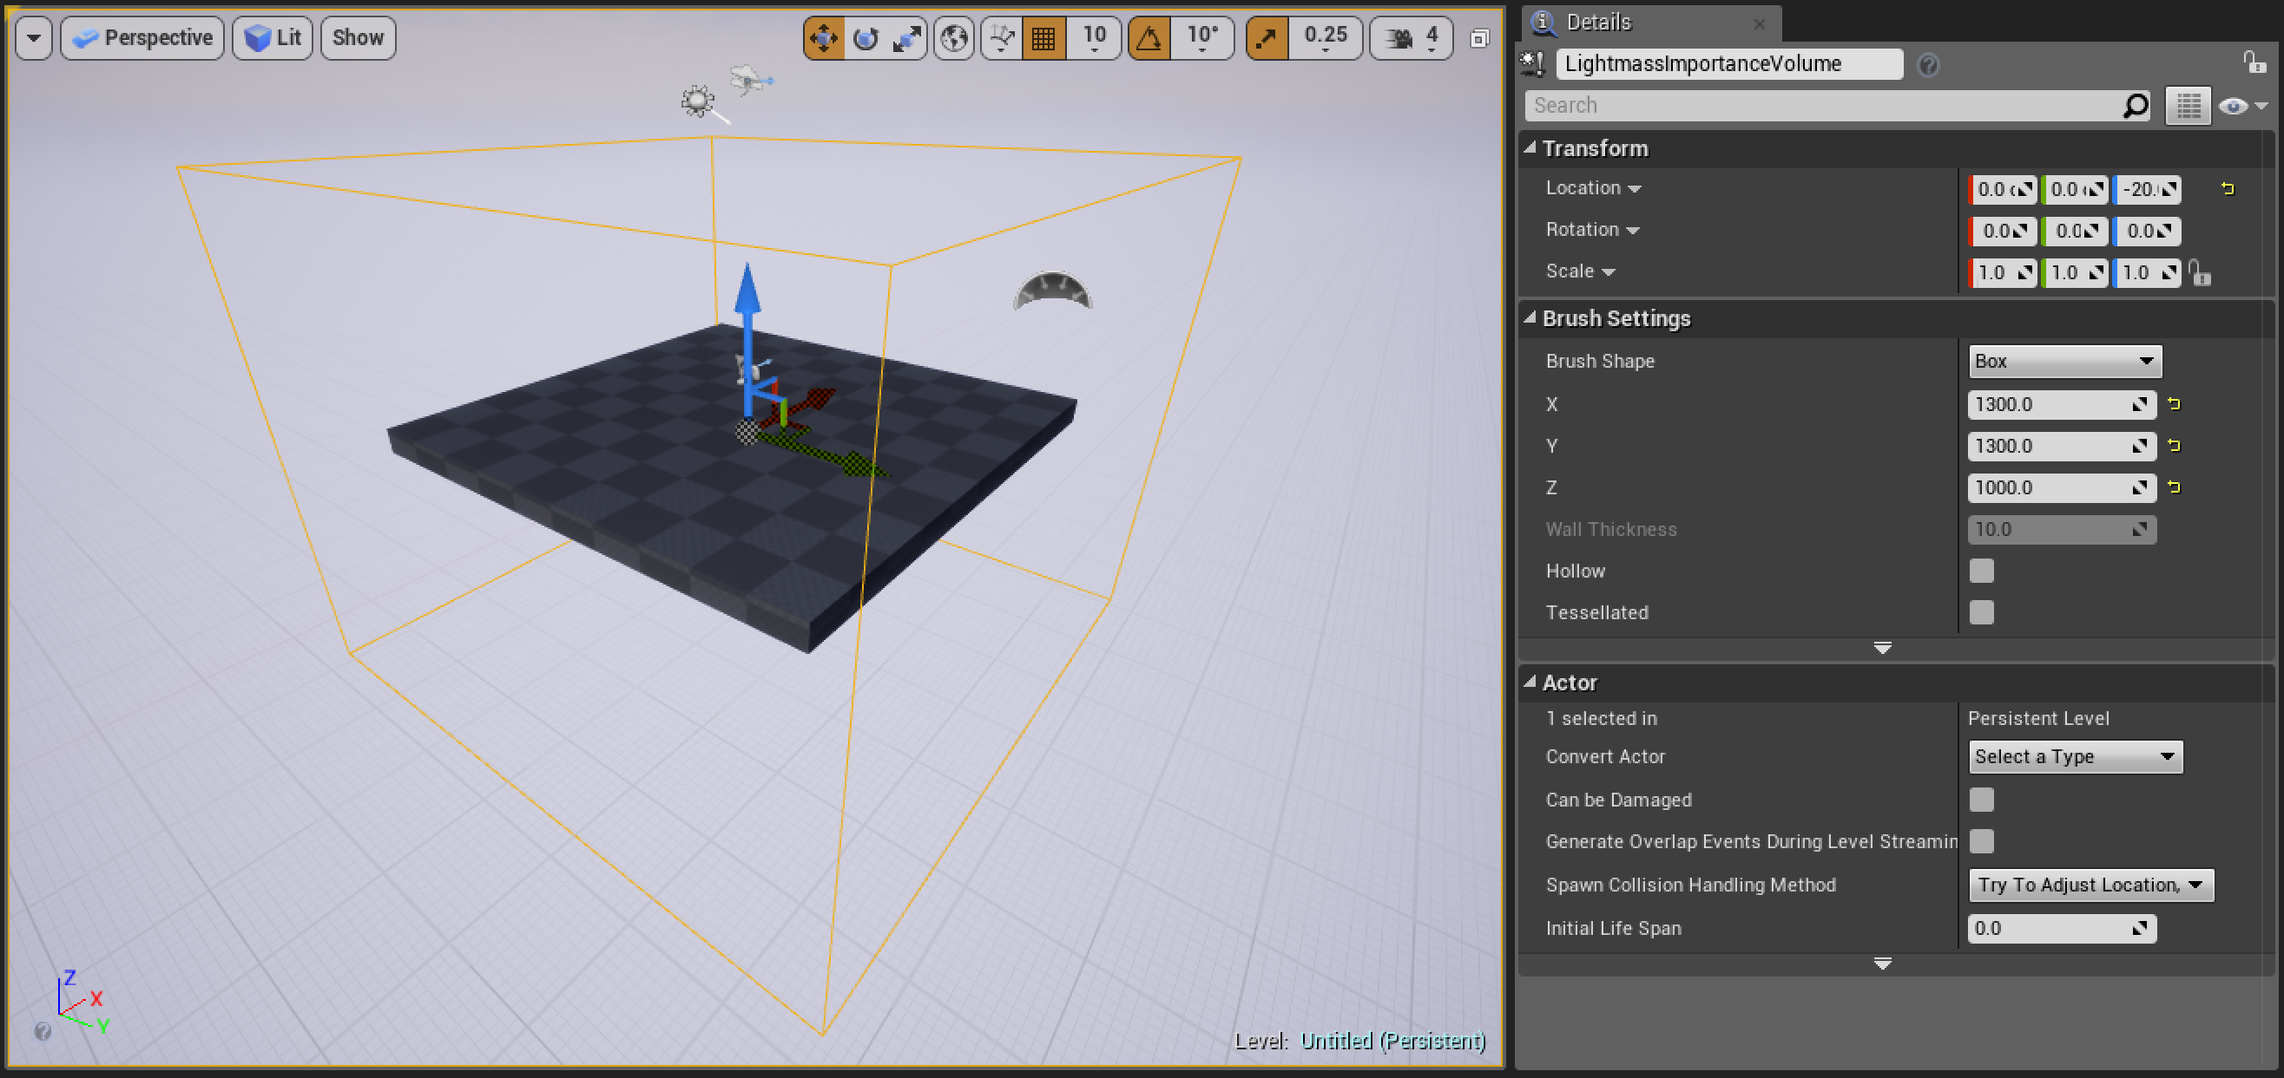
Lightmass Importance Volume
The Lightmass Importance Volume Actor allows you to define an area so that when light leaves the volume it will no longer be processed. This speeds up the time it takes to build lighting.
The Lightmass Importance Volume is located in the Volumes category in the Modes panel.
Once it has been added to your Level, you can adjust the size and shape of the volume in the Details panel under Brush Settings. When placing the volume, you should have it surround the playable areas of your Level.

Slide 27
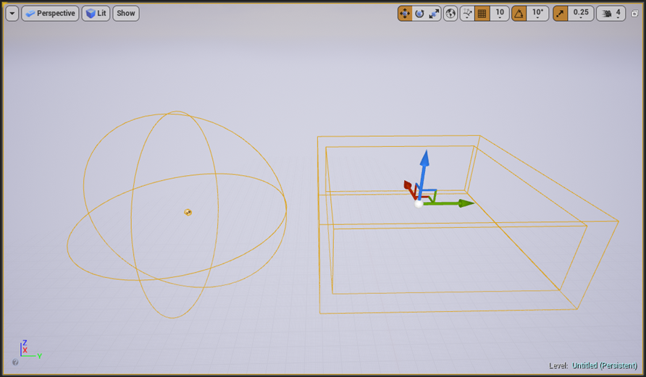
Reflection Capture Actors
Reflection Capture Actors capture images (cubemaps) of the Level from their location and project a reflection onto other Actors in their vicinity if the nearby Actors have Materials with reflective properties.
While Reflection Capture Actors do not create accurate reflections, using them is very effective and efficient because the scene capture is calculated before runtime. You can place them as needed throughout your Level.
Too many overlapping Reflection Capture Actors can impact performance.

Slide 28
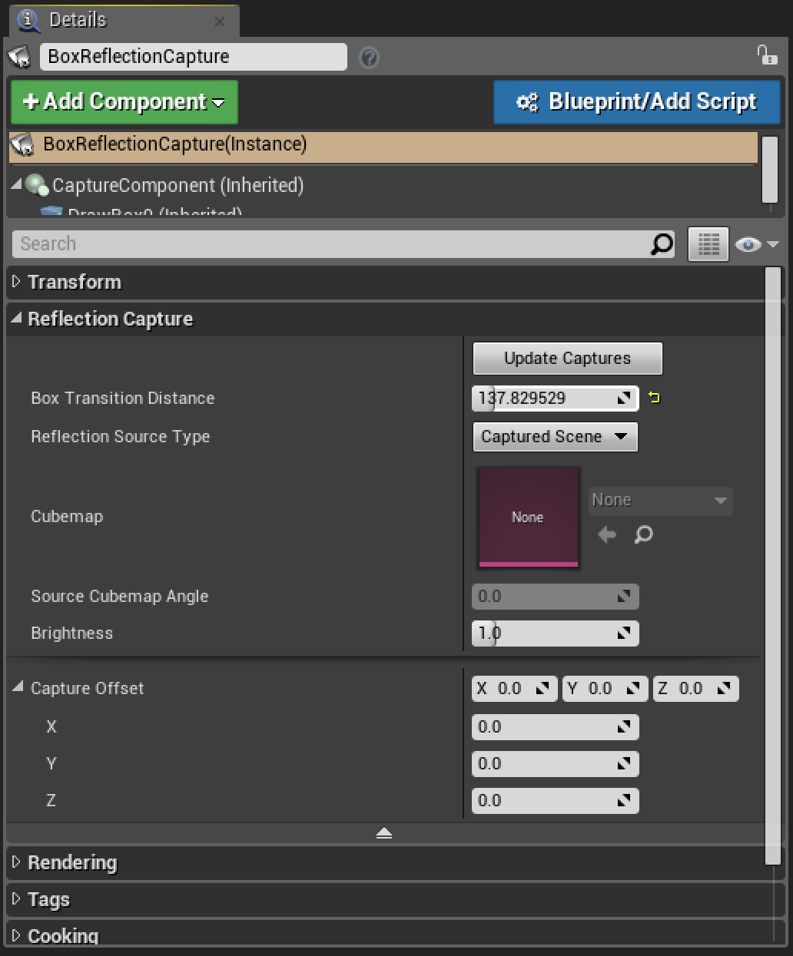
Reflection Capture Actors
There are two common types of Reflection Capture Actors:
Box Reflection Capture Actor
Sphere Reflection Capture Actor
Box Reflection Capture Actors are more expensive to render than Sphere Reflection Capture Actors.
Reflection Capture Actors are located in the Modes panel under Visual Effects.

Slide 29
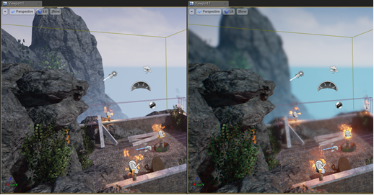
Post Process Volume
Post Process Volumes allow artists to tweak the overall look and feel of a scene. They allow you to control and apply cinematic camera effects. You can adjust properties like Depth of Field, Scene Color, and Motion Blur.
The Post Process Volume is located in the Modes panel under Visual Effects.

Slide 30
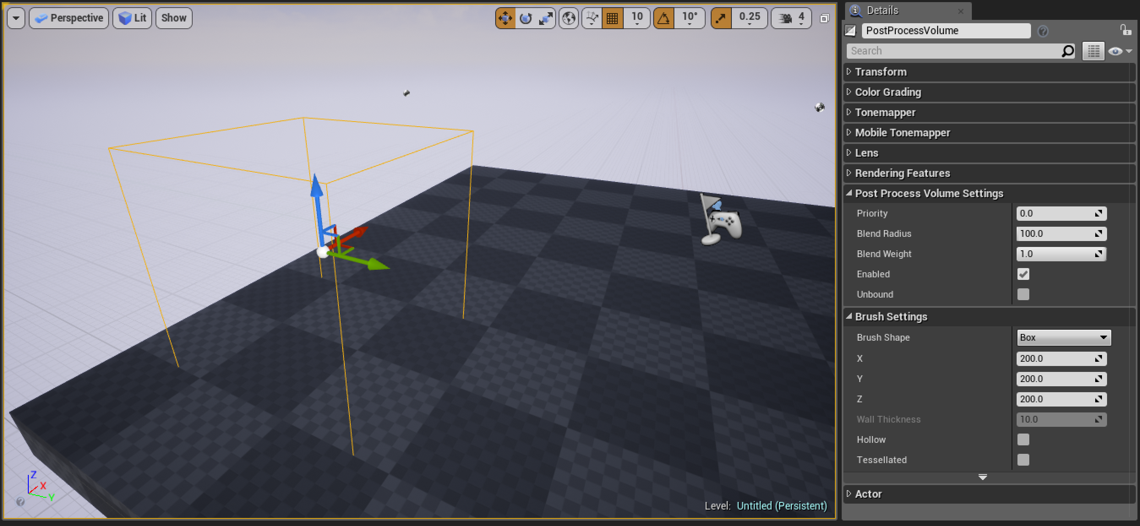
Post Process Volume
Post Process Volumes are used to apply camera effects to areas in your scene defined by a primitive shape. When a camera enters the volume, the effects are applied.

Slide 31
Post Process Volume
Setting | Description
Priority | Defines the order in which multiple volumes are blended together. The volume with the highest priority takes precedence over all other overlapping volumes.
Blend Radius | Distance in Unreal units around the volume at which blending with the volume’s settings occurs.
Blend Weight | The amount of influence the volume’s properties have: 0 is no effect; 1 is full effect.
Enabled | Whether the volume affects the post processing or not. If true, the volume’s settings will be used for blending.
Unbound | Whether the bounds of the volume are taken into account. If true, the volume affects the entire world, regardless of its bounds. If false, the volume only has an effect within its bounds.
Post Process Volume settings allow you to control how effects blend with a camera as the camera enters the volume.

Slide 32
Post Process Volume
You can place multiple Post Process Volumes in your Level, or you can place a single Actor and have it affect the entire Level by turning on Unbound in the Post Process Volume Settings category.
Note: Camera Actors have these same settings.

